Slide 1
POL 103: Intro to Comparative Politics
Conceptualizing and Measuring Democracy
(from Chapter 5 of CGG Principles of Comparative Politics)*
*Scan of relevant pages in Blackboard

Slide 2
Concepts
A state is an entity that uses coercion and the threat of force to rule a given territory
A government is a set of people who run the state; they are the means through which state power is exercised
A regime is a set of rules, norms, or institutions that determine how the government is constituted, organized and major decisions are made
Examples: (post-colonial) United States, the French Fifth Republic
Notes:
When we’re talking about classifying countries as democracies or not, we’re talking about regimes.

Slide 3
Democracy in Historical Perspective
When we talk about democracy or dictatorship (or autocracy) we are typically referring to the categorization of a regime.
We live in a world that (mostly) agrees on the importance and desirability of democracy. (Even North Korea calls itself the Democratic People’s Republic of Korea!)
But it hasn’t always been that way.
Until the middle of the nineteenth century, democracy was associated with an obsolete and ancient political system that was dangerous and unstable.

Slide 4
Democracy in Historical Perspective
The concern with the relative merits of different forms of government goes back at least as far as Aristotle and Plato.
Democracy comes from the Greek word, Demokratia normally gets translated as “rule by the people” but without distinguishing who the people are.
Demos, for the ancient Greeks, actually referred to the “common people.”
And, demokratia wasn’t exactly seen as good by them.
Seen as something like mob rule.

Slide 5
Democracy in Historical Perspective
Fast-forward to 19th century Europe:
Democracy was seen as obsolete.
It meant direct legislation by (a subset of) the people, not by representatives of the people.
It could work in Athens but most people thought that it could not work in the modern world.
Important distinction between:
Direct democracy (mostly ancient) – the people vote directly -- disagreement over who should be “the people”
Representative democracy (modern): the people vote for (choose) their representatives -- still disagreement over who should be “the people” and also how they should elect their representatives.

Slide 6
Questions
We want to answer substantive questions like the following ones.
Do democracies or dictatorships lead to higher levels of growth?
Do democracies or dictatorships increase life expectancy?
What factors increase the survival of democracies?
What factors increase the probability that a dictatorship will become a democracy?

Slide 7
Questions
To answer these questions, we need to be able to classify countries as democracies or dictatorships.
These questions about measuring abstract political phenomena apply equally well to other concepts, such as representation, culture, identity, etc.
In other words:
How do we know a democracy when we see one?

Slide 8
Dahl’s View of Democracy
How do we translate our abstract concept of democracy into a practical set of criteria for classifying democracies?
Two Views of Democracy.
Substantive View: Classify political regimes in terms of the outcomes that they produce.
Procedural [or Minimalist] View: Classify political regimes in terms of their institutions or procedures.
Democratic theorist Robert Dahl argued that we should use a procedural or minimalist view of democracy.

Slide 9
Dahl’s View of Democracy
Dahl did not believe that any country in the world was ever fully democratized. Instead, he used the idea of polyarchies: regimes somewhere between pure authoritarianism and pure democracy
Polyarchies were based on two dimensions.
Inclusion–who gets to participate in politics?
Contestation–extent to which citizens have organized themselves into competing blocs (democratic competition).
Dahl’s insights have been incorporated into many measures of democracy.

Slide 10
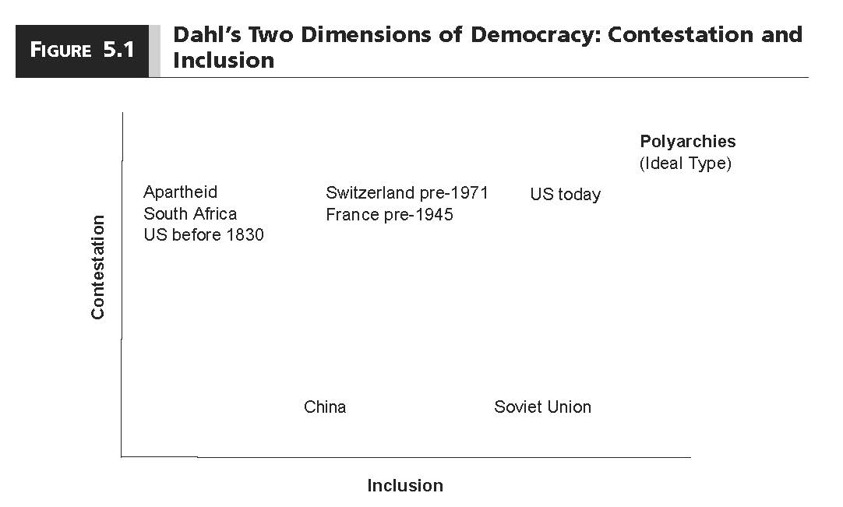

Slide 11
Measuring Democracy
How have political scientists operationalized the concept of democracy?
What are the strengths and weaknesses of these operationalizations?
We focus on three measures.
Democracy-Dictatorship (DD)
Polity IV
Freedom House

Slide 12
Democracy-Dictatorship (DD)
Builds on Dahl’s (1971) notion of “contestation” and Schumpeter’s (1942) notion of competition.
Democracy is a regime “in which governmental offices are filled as a consequence of contested elections.”
Empirical scope is 199 countries from 1946 (or independence) to 2008.

Slide 13
Democracy-Dictatorship (DD)
A country is a democracy if:
The chief executive is elected.
The legislature is elected.
There is more than one party competing in elections.
There has been an alternation in power under identical electoral rules.
If any one or more of these four conditions does not hold, then the country is a dictatorship.
A country is either a dictatorship or a democracy.

Slide 14
Democracy-Dictatorship (DD)
Contestation is very important for DD.
Contestation occurs when there is an opposition that has some chance of winning office as a consequence of elections.
Ex ante uncertainty: outcome of election is not known before it takes place.
Ex post irreversibility: the winner of the electoral contest actually takes office.
Repeatability: elections occur at regular and known intervals.
Voters must have at least two alternatives to choose from
States where voters only have a single party list are excluded (i.e., Syria, Turkmenistan and Vietnam)
Notes:
DD is mostly or completely unconcerned with Dahl’s inclusion dimension

Slide 15
Democracy-Dictatorship (DD)
Contested elections are a necessary, but not sufficient, condition for DD classification of democracies.
You also need an alternation in power.
Why?

Slide 16
Democracy-Dictatorship (DD)
The problem is that it is difficult to distinguish between regimes in which (a) incumbents never lose power because they are popular and (b) incumbents hold elections only because they know they will not lose them.
The two cases are observationally equivalent.
Botswana, Japan, Malaysia, Mexico.

Slide 17
Democracy-Dictatorship (DD)
DD builds on Dahl in two ways.
Purely procedural or minimalist view of democracy.
Focuses on Dahl’s notion of contestation.
The main difference is that DD treats regime type as a dichotomy (either democracy or dictatorship) rather than as a continuum (more or less democratic).

Slide 18
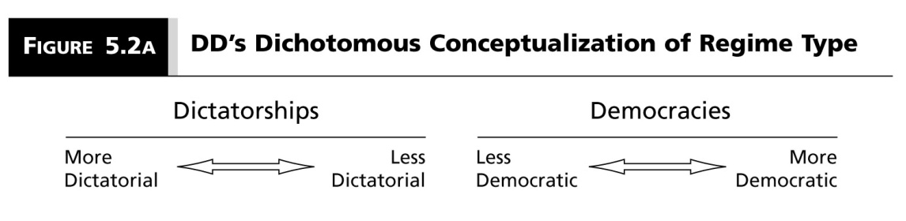
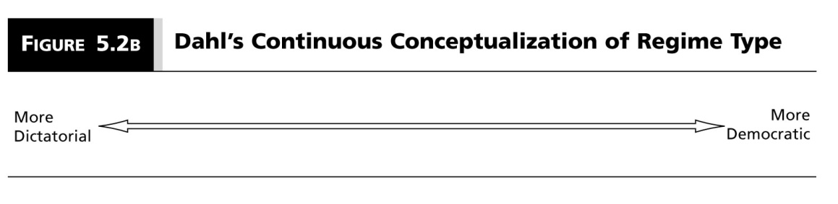
Classification of Regime Types

Slide 19
Polity IV
Empirical scope is 190 countries from 1800 to the present.
Provides an annual evaluation of democracy and autocracy.
Democracy Measure 0-10.
Autocracy Measure 0-10.
From these two measures it provides a Polity Score.
Polity Score = Democracy Measure–Autocracy Measure.
Ranges from –10 to 10.
Polity: +6 -- + 10 : Democracies
Polity: -5 -- +5 : Mixed regime
Polity: -6 -- -10 : Dictatorships

Slide 20
Polity IV
This measure is based on five attributes.
Competitiveness of executive recruitment
Openness of executive recruitment
Executive constraints/decision rules
Regulation of political participation
Competitiveness of participation
Each attribute is worth a different number of points. When coming up with an overall democracy or autocracy score, each attribute is weighted differently.
Notes:
1: how are they chosen? Elections, coups, hereditary?
2: who gets to be chosen?
3. Who does executive have to listen to?
4. How are groups that participate in politics organized?
5. Who is allowed to compete?

Slide 21
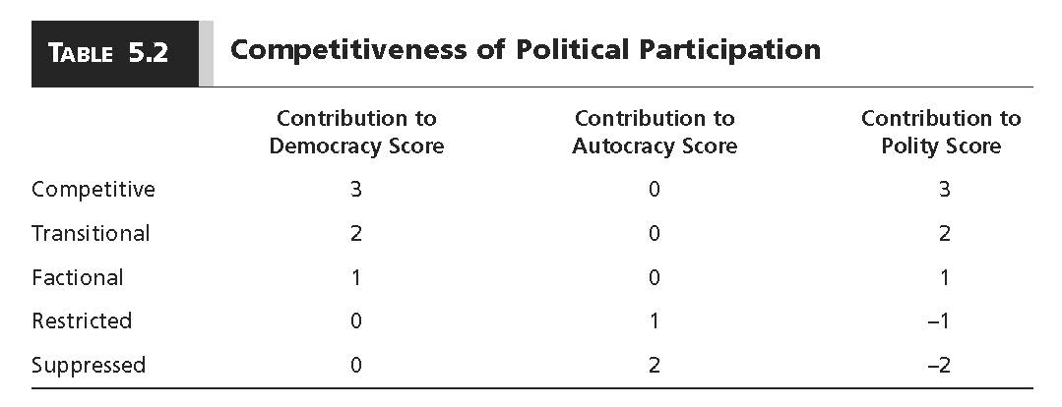
Polity IV

Slide 22
Polity IV: Competitiveness of Participation
The Competitiveness of Participation: the competitiveness of participation refers to the extent to which alternative preferences for policy and leadership can be pursued in the political arena.
(1) Repressed: No significant oppositional activity is permitted outside the ranks of the regime and ruling party.
(2) Suppressed: Some organized, political competition occurs outside government, without serious factionalism; but the regime systematically and sharply limits its form, extent, or both in ways that exclude substantial groups (20% or more of the adult population) from participation.
(3) Factional: Polities with parochial or ethnic-based political factions that regularly compete for political influence in order to promote particularist agendas and favor group members to the detriment of common, secular, or cross-cutting agendas.
…

Slide 23
Polity IV: Competitiveness of Participation
…. Continued
(4) Transitional: Any transitional arrangement from Restricted, Suppressed, or Factional patterns to fully Competitive patterns, or vice versa. Transitional arrangements are accommodative of competing, parochial interests but have not fully linked parochial with broader, general interests. Sectarian and secular interest groups coexist.
(5) Competitive: There are relatively stable and enduring, secular political groups which regularly compete for political influence at the national level; ruling groups and coalitions regularly, voluntarily transfer central power to competing groups. Competition among groups seldom involves coercion or disruption. Small parties or political groups maybe restricted in the Competitive pattern.

Slide 24
Freedom House
Empirical scope is 194 countries (and 14 territories) from 1972 to the present.
Not explicitly a measure of democracy. It is an annual evaluation of the state of “global freedom.”
Freedom has two broad categories.
Political rights (right to vote and compete for office, and so on)
Civil rights (freedom of speech and so on)
Based on Universal Declaration of Human Rights
Based on scores for political and civil rights, Freedom House classifies countries as Free, Partly Free, and Not Free.

Slide 25
Freedom House
Political rights
Country is awarded 0-4 points for each of 10 questions.
Take these points and place on a 1-7 scale.
Civil rights
Country is awarded 0-4 points for each of 15 questions.
Take these points and place on a 1-7 scale.
Take the average of these two 7-point scales and determine if a country is free (1-2.5), partly free (3-5.5) , or not free (5.5-7).
In contrast to Dahl, DD, and Polity IV, Freedom House takes a substantive view of democracy.

Slide 26
Freedom House
Types of Political Rights Questions.
Is the head of state elected in free and fair elections?
Is there pervasive corruption?
Is the government accountable between elections? is it open and transparent?
Do people have the right to organize?
Is there a competitive opposition?
Do minorities have reasonable autonomy?

Slide 27
Freedom House
Types of Civil Rights Questions
Is the media free and independent?
Are there free religious organizations?
Is there an independent judiciary?
Is there equal treatment under the law?
Are there free trade unions?
Is there equality of opportunity?
Do citizens have the right to own property?

Slide 28
Polity & Freedom House: More Info
For Polity:
Some recent data.
Methodology.
For Freedom House:
Some recent data.
Methodology.

Slide 29
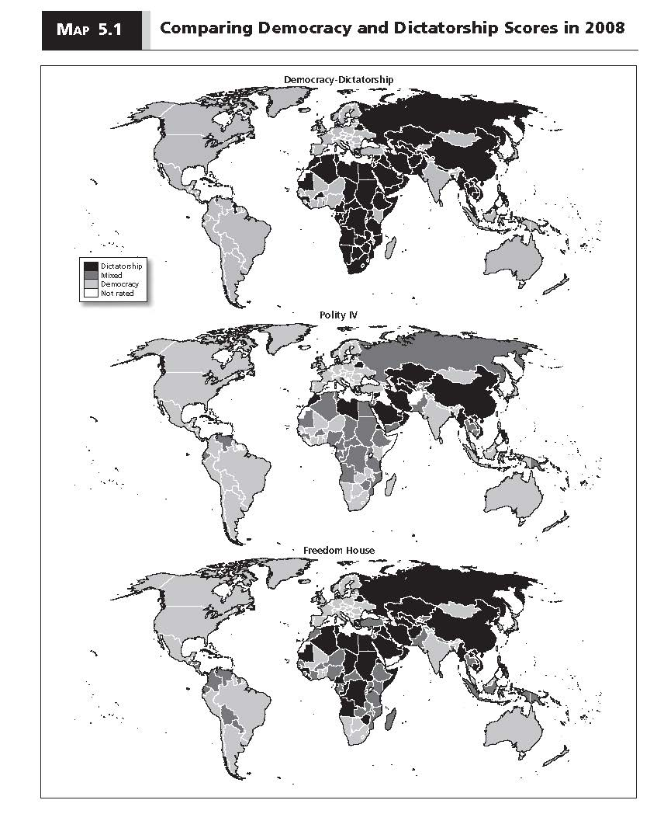

Slide 30
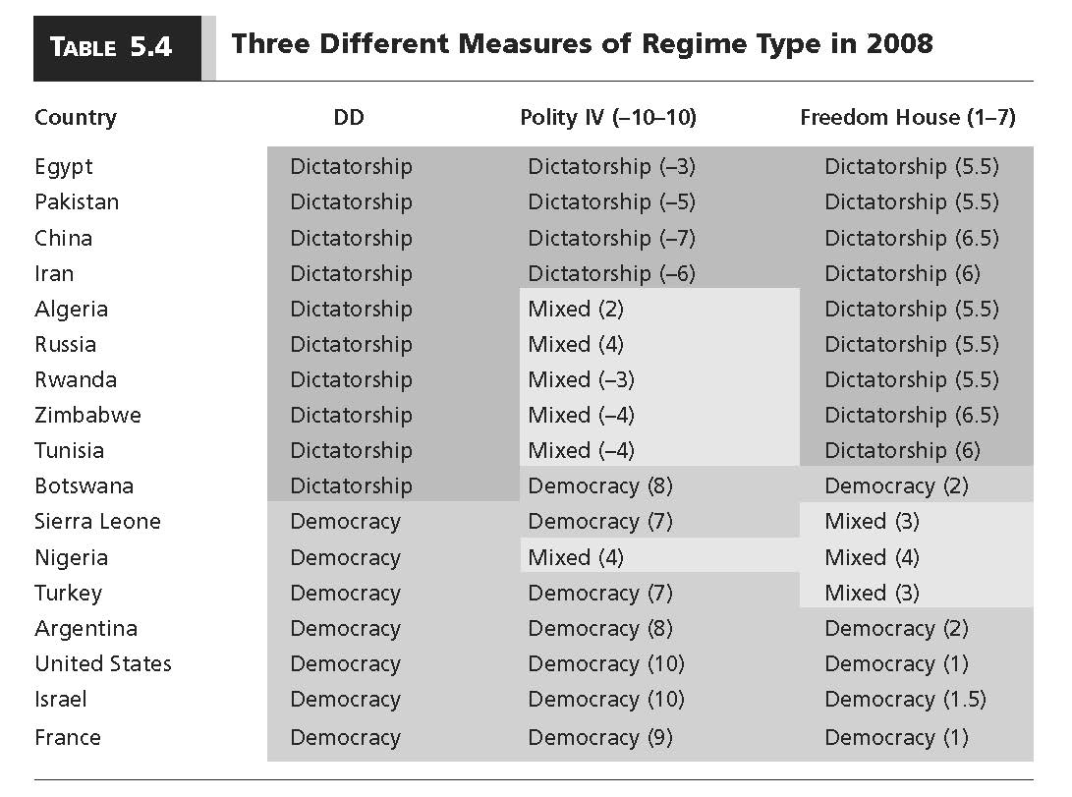

Slide 31
Conceptualization
Conceptualization is the process of creating mental categories that capture the meaning of objects, events, or ideas.
Should we use a minimalist or substantive conceptualization of democracy?

Slide 32
Conceptualization
Minimalist (Procedural) View
Democracy depends exclusively on the presence of certain institutions, with no reference to the kinds of outcomes that are generated.
DD (only contestation) and Polity IV (contestation and inclusion).
Substantive View
Institutions are seen as necessary, but not sufficient, to characterize regimes.
Representation, accountability, economic equality, rationality, and so on.
Freedom House.

Slide 33
Conceptualization
POLITY explicitly throws shade on substantive democracy:
Institutionalized Democracy: Democracy is conceived as three essential , interdependent elements. One is the presence of institutions and procedures through which citizens can express effective preferences about alternative policies and leaders . Second is the existence of institutionalized constraints on the exercise of power by the executive. Third is the guarantee of civil liberties to all citizens in their daily lives and in acts of political participation. Other aspects of plural democracy, such as the rule of law, systems of checks and balances, freedom of the press, and so on are means to, or specific manifestations of, these general principles. We do not include coded data on civil liberties.

